Slide 1


Computing in Context: Fall 2024
Lecture 1 | Overview
Statistical brief overview
Dr Sarah Ashcroft-Jones | Mailman School of Public Health

Slide 2
Second Quarter – Context-focus
2 lectures – more theoretical
1 lab – more practical
Assignments – introduced and explained next week
Disclaimer

Slide 3
Health Policy
Notes:
Health policy is defined by the World Health Organization as the decisions, plans, and actions that are undertaken to achieve specific healthcare goals within a society.
What is health policy?
Why do we have health policy?
How do policies get made?

Slide 4
Health Data
Notes:
What is it?
Why do we need it?
How do we use it?

Slide 5


Evidence based decision making
Health Policy
Health Data
Evidence based Health policy
Notes:
In an ideal world – data over ideology
To enact policy change: bills are presented and debated using evidence and expert testimony to understand the issue
Gold standard: Evidence based health policy
e.g. smoke free policy and water fluoridation

Slide 6
Data and Computing
An important aside

Slide 7
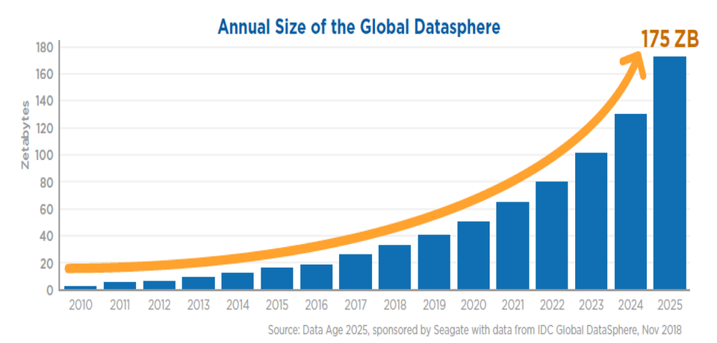
Amount of Data Created Each Year

Slide 8
Scale of the Global Data Growth
1 zettabyte = a trillion gigabytes
1 gigabyte = 1000 megabyte,
1 megabyte = 1000 kilobytes
1 kilobyte = 1000 bytes
Each byte has 8 bits of information
A bit is the smallest unit of digital information
Downloading global datasphere would take 1.8 billion years
Notes:
Average laptop between 8 -16g of RAM

Slide 9
Why does it matter?
Data is out there – do you need more?
Finding signal in the noise – how?
Limit may not be your data but your compute

Slide 10
Hardware Components of Computing
Processor (i.e. CPU): The more powerful the processor is, the faster it can perform tasks assigned to it
Memory (i.e. RAM): Akin to your brain’s “working memory” – larger memory means the processor can operate on more info
Storage (i.e. HDD or SDD): Akin to your brain’s “long-term memory” – data that is not currently being used, but is kept for retrieval/editing
Notes:
Aside – look at computer resources monitor

Slide 11
“The Big Data Revolution”
In the past 50 years - explosion in the processor speed, memory size, and storage density
In the past 20 years - broadband (high-speed) internet networks have grown, rapid transmission of large quantities of data between computers now feasible
This makes data more useful, as it can be communicated to others

Slide 12
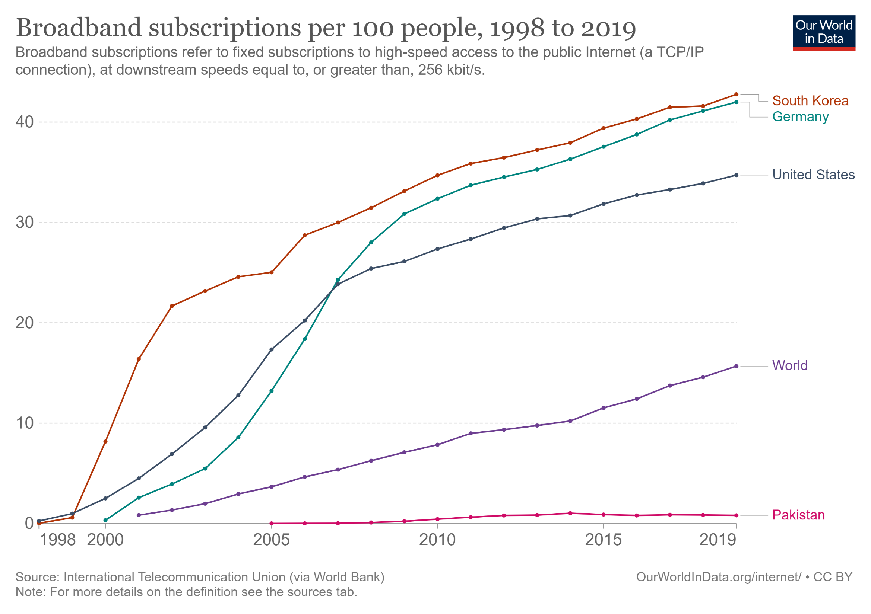

Slide 13
Health data
Where does it come from?

Slide 14
Traditional Data Source: Surveys
Historically, health data not readily available (or recorded)
Records weren’t digitized (in many cases they still aren’t!)
So, quantitative HP research data was collected explicitly:
Example: surveys administered by government agencies
e.g. the National Health Interview Survey (NHIS), administered by the Census Bureau since 1957

Slide 15
Upsides to survey data:
Survey designer can choose what information is collected
Data is generally well-structured → “ready” to analyze
Downsides to survey data:
Expensive to collect → limits sample size & question #
Respondents may provide inaccurate information
Can only know what the respondent can readily recall

Slide 16
Administrative Data
Information on/for the operations of large organizations:
Since Mesopotamians in 7500 BC – clay tablets for bookkeeping
E.g. Land deeds, government proceedings, tax rolls, records of births/deaths/marriages.
From hard copy data: unreliable, errors, data loss, sharing …
To digitization in 20th and 21st centuries with growing compute …
Notes:
Hard copy nature made collection, sharing, transmission, and analysis time-consuming and unreliable.
Digitization of records in the 20th and 21st centuries, along with exponential growth of storage and computational capacities, has allowed for organizations to collect ever-larger and richer forms of administrative data

Slide 17
Modern Administrative Data
Accounting records
Inventory tracking
Customer service
Human resources
Tax records
Health records
Insurance claims
Goal of administrative data is to keep detailed records for future reference, so this data is inherently “big”:
Both in the number of entries recorded, and the activities recorded
Notes:
We’ll come back to a working definition of “big data” later today
Knowledge is power: Being able to produce, store and effectively analyze this data can lead to massive improvements in individual and organizational productivity.

Slide 18
(Dis)Advantages of Administrative Data
Typical advantages of admin data relative to survey data:
Larger sample sizes
More precise measurement
Less bias in responses
Larger number of variables
Typical disadvantages of admin data relative to survey data:
Not be crafted for analyst’s intended purpose
Unlikely to capture important measures of interest
Notes:
(more statistical power)
(no fuzzy human recall)
(no dishonest survey responses)
(not limited to questionnaire)
(e.g., subjective measures like perceived wellbeing, happiness)

Slide 19
Administrative Data in Healthcare
The healthcare system produces two unique, massive forms of admin data used by researchers, managers, and policymakers:
Health Insurance Claims
Electronic Health Records (EHR)
Notes:
Health Insurance Claims: records of services rendered by healthcare providers that are sent to health insurers, who use this to determine how much pay the providers
Electronic Health Records (EHR): records that contain information about individual patients, as well as their treatment by healthcare providers

Slide 20
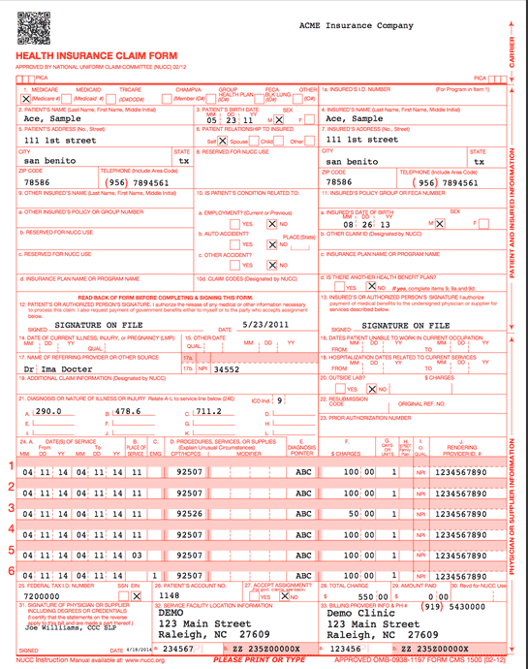
Sample Health Insurance Claim Form
Patient Identifiers, DOB, Sex
Provider ID, Diagnosis Codes
Procedure Codes, Date, Provider IDs

Slide 21
Administrative Data in Healthcare
An individual claim can’t tell you much about the patient
Basic demographics
Diagnosis codes given by the provider
Provider IDs, and the services they rendered
However, observing all claims for an individual over an extended period can give the analyst (you!) sense as to their health status

Slide 22
Electronic Health Records
On the other hand, electronic health records (EHR) can give a much clearer picture of an individual’s health
Detailed date/time data
Patient vitals (heart rate, blood pressure, BMI, etc.), lab values
Physician notes, medical history
Diagnoses, Procedures, imaging (MRI, X-ray, etc.)
And more…

Slide 23
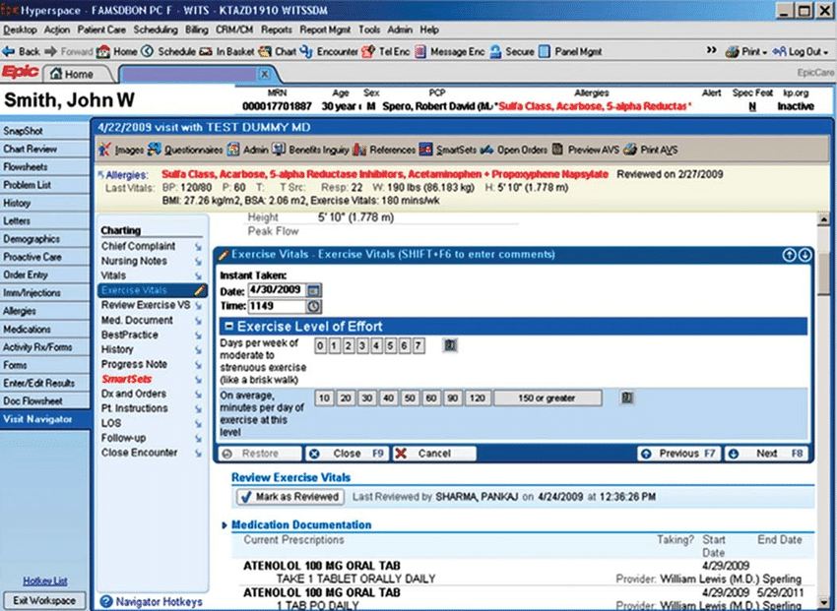
Electronic Health Records (EHR)
Sallis et al. (2016)

Slide 24
Data Details
Structure, content, and “big” data

Slide 25
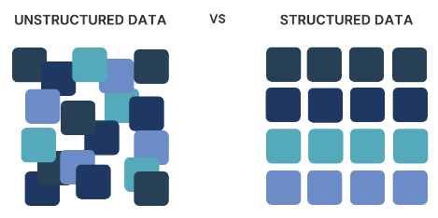

Slide 26
Data: “Structured” vs “Unstructured”
In your courses, it’s possible you’ve only worked with “structured” data – clearly defined and categorized easily
But most real world data is unstructured.
Intuition for “structured” vs. “unstructured”:
“Could this type of data be readily analyzed in a spreadsheet?”
“yes” = structured.

Slide 27
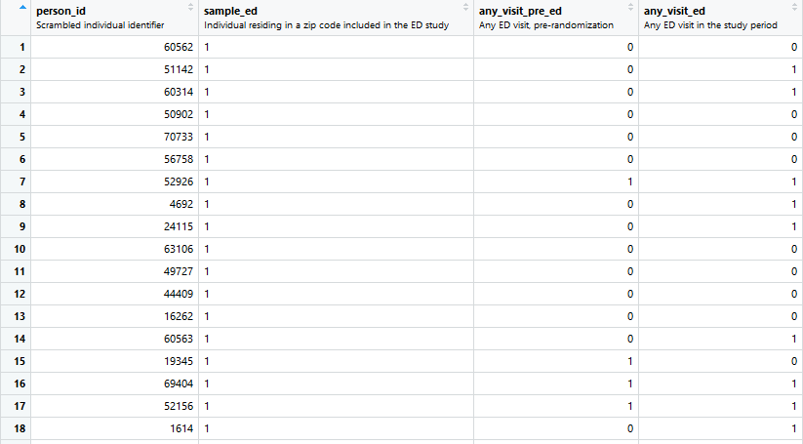
Example: Structured Data
Notes:
Unstructured – emails, text, audio, image data,

Slide 28
Healthcare Data: Structured and Unstructured
“Less than 15 percent of health data in EHRs are entered in structured data fields.” (Roski et al., 2014)
Traditionally, structure was a precondition for analysis and retrieval
But “big data” approaches enable the efficient linkage and analysis of unstructured data to answer operational or research questions

Slide 29
Transforming Data
A large part of what folks call “data science” consists of “ETL” (Extract, Transform, Load) tasks
“How do I extract data of interest in its current (often raw, unstructured) form, and transform it so that it can be more easily used?”
Example: suppose you’d like to use the unstructured text from physicians’ EHR notes to better predict future adverse health outcomes for patients. How might you do this?

Slide 30
Example: Structuring Physician Notes
Perhaps you know a keyword that would be helpful to identify:
Generate flag (i.e., “dummy”) variables for each patient encounter that indicate whether the physician used that word in her notes.
Maybe not and they all could be important?
Generate a flag for each word/phrase in the physician notes?
… thousands of variables (think: Pandas Dataframe columns)!

Slide 31
Data Dimensions: “Long” vs. “Wide”
cardiac | pain | stroke
1 | 0 | 0
0 | 1 | 0
0 | 1 | 0
0 | 0 | 0
1 | 0 | 0
1 | 0 | 0
0 | 1 | 1
0 | 0 | 0
0 | 1 | 0
0 | 1 | 0
0 | 0 | 0
1 | 1 | 0
0 | 0 | 0
cardiac | pain | stroke | male | leg | head | sharp | fever | blood
1 | 0 | 0 | 0 | 0 | 0 | 0 | 0 | 1
0 | 1 | 0 | 1 | 1 | 0 | 1 | 0 | 0
0 | 1 | 0 | 1 | 0 | 0 | 1 | 0 | 1
0 | 0 | 0 | 0 | 0 | 0 | 0 | 0 | 1
1 | 0 | 0 | 0 | 0 | 0 | 0 | 1 | 0
1 | 0 | 0 | 0 | 1 | 0 | 0 | 0 | 1
0 | 1 | 1 | 1 | 0 | 1 | 1 | 0 | 0
N
K
N: # of observations in dataset (rows)
K: # of variables in dataset (columns)
When K is large: “wide” data
When N is large: “long” data
“wide” and “long” are NOT mutually exclusive terms!

Slide 32
Defining “Big Data”
“Big Data” can be used to refer to data that is wide or long, but is typically both, and often contains unstructured data fields.
Generally, we’re talking about data that’s so “big” that it cannot be contained in the memory of a typical computer.
However, most “Big Data” analysis tools (like machine learning algorithms) are uniquely suited to handling wide data – finding patterns across large combinations of variables.

Slide 33
Big Data: Linking Across Sources
Another important aspect that contributes to the ‘width’ of Big Data is that datasets from separate administrative sources are often “merged” together to address questions.
Examples:
A health system linking SSA death records to its EHR, enabling it to better measure patient (past and present) outcomes
Merging IRS income tax records with data from a randomized policy evaluation, to determine its effect on subsequent employment

Slide 34
Real-Time Digitization of Health
The advances in computing capacity have lead to proliferation of interconnected mobile devices (the “internet of things”)
This is not restricted to telecommunication and consumer electronics – consider recent developments in health
Mobile imaging
“Wearable” technology (heart rate and blood pressure sensors, glucose monitors, exercise trackers, health apps)
This data is all stored somewhere…

Slide 35
Data Misuse Concerns
Given the sensitive nature of health data, there are concerns regarding the security of personally identifiable information (PII).
It can be surprisingly easy to trace even “de-identified / anonymized” data back to a specific an individual especially with the data is “wide” or the sample is specific
In addition to privacy, also concern that such data could be misused to illegally discriminate against individuals/groups

Slide 36
Questions?
Statistical brief overview
Dr Sarah Ashcroft-Jones | Mailman School of Public Health

